Slide 1
PAPER REVIEW
An absolute Optical Character Recognition system for Bangla script Utilizing a captured image
Course: Applied Data Science Submitted By: ADNAN AL SAYEED SIHAB
ID: 22141026

Slide 2
Table of contents
01
02
03
04
05
06
ABSTRACT OVERVIEW
METHODOLOGY
DATASET
DATA PREPROCESSING
RESULT And Comparison
Limitations

Slide 3
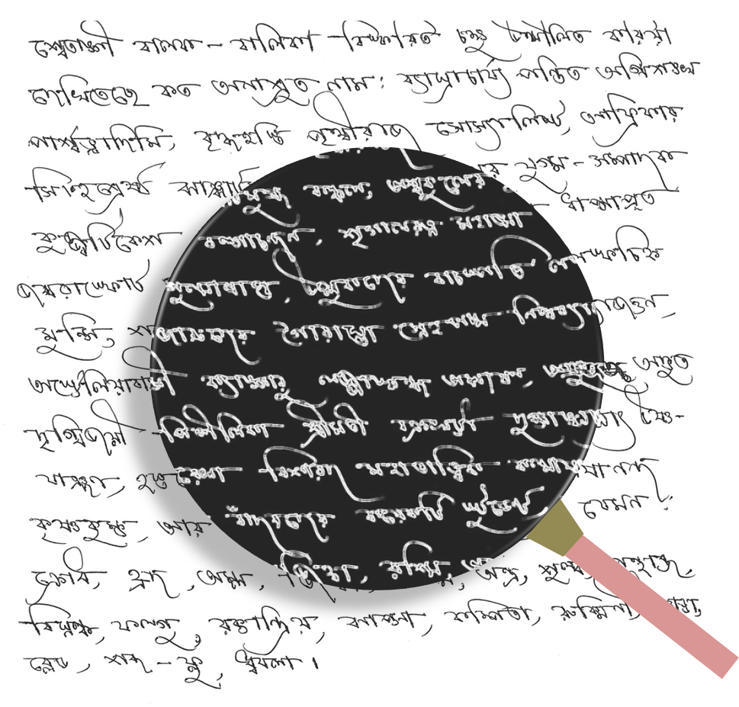
ABSTRACT OVERVIEW
The paper aims to develop an optical character recognition (OCR) system that can recognize Bangla text from captured images. Here, the author proposed an idea that the system performs preprocessing steps like binarization, segmentation, noise cleaning etc. and uses Freeman chain code for feature extraction. The success rate of identifying characters is approximately 99%.

Slide 4
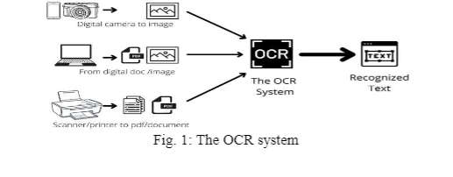
METHODOLOGY
- The methodology includes preprocessing, feature extraction from segmented characters, training a neural network and recognition.
- The proposed OCR system comprises several steps, including binarization, segmentation, noise cleaning, scaling, skew detection, and correction. Features are extracted from segmented characters like slope, centroid, bounding box etc.

Slide 5
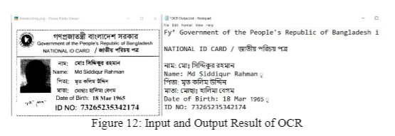
DATASET
Raw images containing Bangla script are collected using a digital camera or scanner. Fonts used for training include SutonnyMJ, Sulekha, Dhansiri MJ, Nirmala UI in sizes 7pt to 26pt. A neural network to gather information about Bangla text Scripts. They have also used a flatbed scanner with a maximum of 1200 dpi for collecting raw images containing Bangla Script.

Slide 6
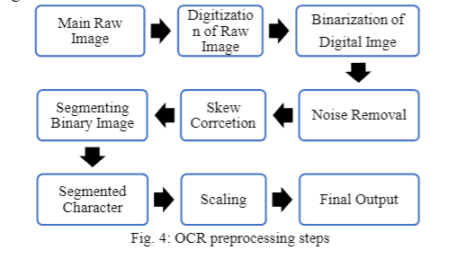
DATA PREPROCESSING:
The preprocessing steps involve converting the captured raw images into binary.
Likewise form (binarization), segmenting the characters, removing noise, scaling the characters based on font size, detecting and correcting skew into lines, words and characters and representing the characters using the Freeman chain code.
Techniques applied are curve scanning, greedy search etc. to segment overlapping and touching characters.

Slide 7
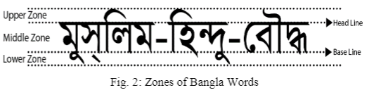
Matra Discovery
A multilayer feedforward neural network is used for character recognition and classification.
The authors introduced the concept of "Matra Discovery" in Bangla text recognition. They defined "Matra" as the headline of a Bangla word and proposed a greedy search algorithm to identify the part of a Bangla character located above the Matra row.

Slide 8
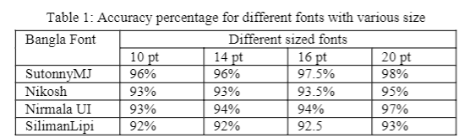
RESULT:
The Feedforward neural network shows a success rate of approximately 99% on regular scanned/captured images with standard fonts and sizes in identifying Bangla characters using the proposed OCR system. The system demonstrates high accuracy in recognizing and extracting Bangla text from captured images. It also shows accuracy reduces for stylish/handwritten fonts and noisy images not present in the training set.

Slide 9
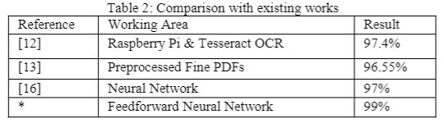
RESULT COMPARISON:
The system outperforms existing works achieving higher accuracy than Tesseract OCR and other neural network models. The performance of the proposed OCR system is compared with previous works in the field. The system shows improved recognition rates and demonstrates its effectiveness in handling the complexities of Bangla script.

Slide 10
Limitations:
- The OCR system developed in the paper may fail to achieve better accuracy if the input image is skewed or rotated.
- It does not apply any algorithm for skew detection and correction. The paper also acknowledges that better algorithms are needed to accurately detect and segment modifiers that are merged with characters.
- Recognition accuracy reduces for low quality captured images, non-standard fonts and font sizes not in the training set.

Slide 11
Reference
M. R. Siddique and M. A. Mahmood, "An absolute Optical Character Recognition system for Bangla script Utilizing a captured image," 2021 Emerging Technology in Computing, Communication and Electronics (ETCCE), Dhaka, Bangladesh, 2021, pp. 1-6, doi: 10.1109/ETCCE54784.2021.9689855.

Slide 12
Thank You

